Slide 1
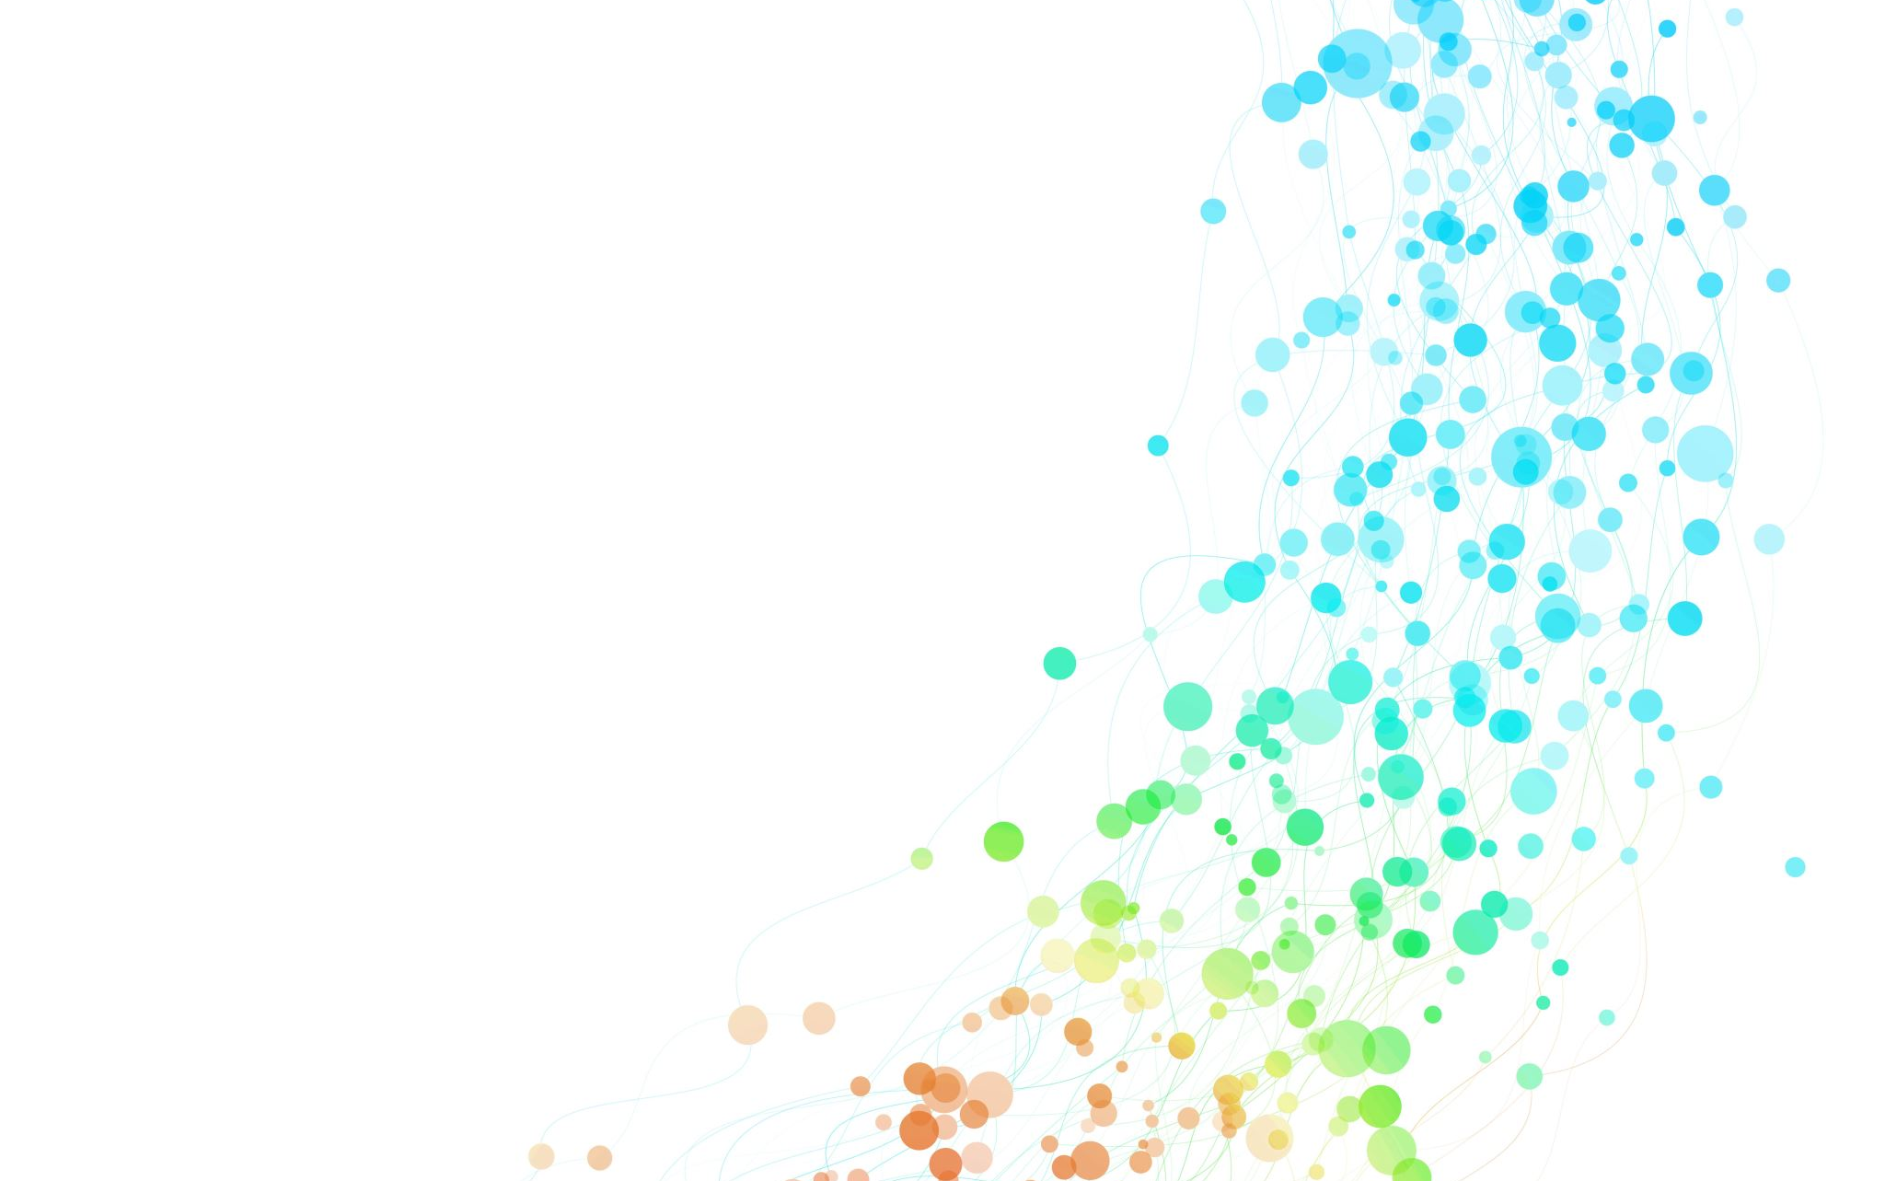

DS01 INTRODUCTION TO DATA SCIENCE Why is it Important?
Rudy C. Yuen
MEng Mathematical Computation

Slide 2


Data Science?
+
=

Slide 3


What is Data
Knowledge about us
Browsing History
Memes
What we speak

Slide 4

Data Science?
Analytics of Data using different Methodologies
Machine Learning
Statistics
Algorithms
Mathematics

Slide 5
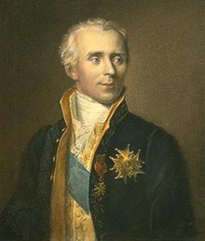
Laplace’s Demon
“According to determinism, if someone (the demon) knows the precise location and momentum of every atom in the universe, their past and future values for any given time are entailed; they can be calculated from the laws of classical mechanics.” - Laplace's demon – Wikipedia
“Precise Location and Momentum”
This is Data!

Slide 6




Artificial Intelligence

Slide 7
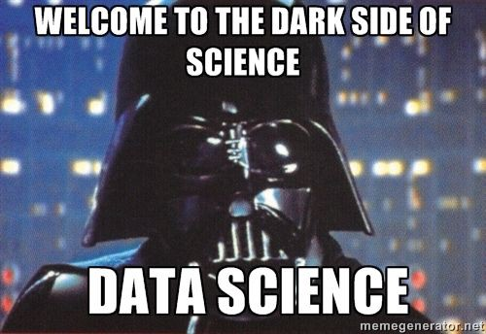
Machine Learning 101

Slide 8
Machine Learning
Teaching your program how to think the way you want it to
Key idea:
You feed the program with some data
It gives you back a response
You reply how correct it is
The computer learns
Yes, it is like teaching a toddler

Slide 9

Machine Learning (Slightly More Mathematical)
$f\left(x\right)=mx+c$
$f\left(x\right)=1x+0$

Slide 10
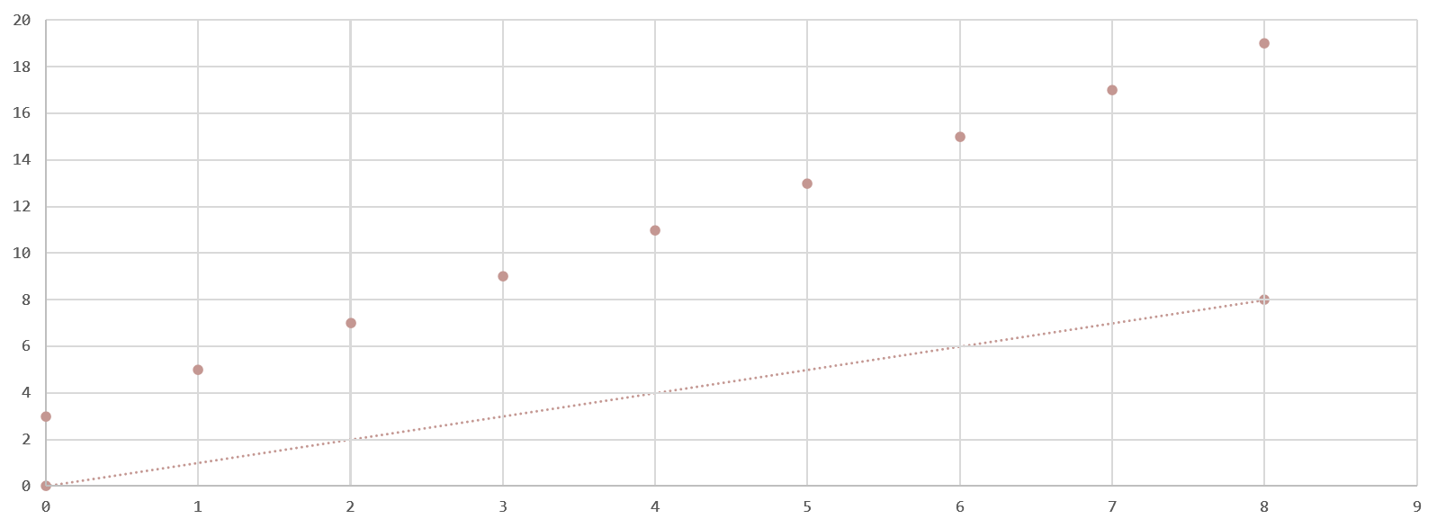

Machine Learning (Slightly More Mathematical)
$f\left(x\right)=1x+0$

Slide 11
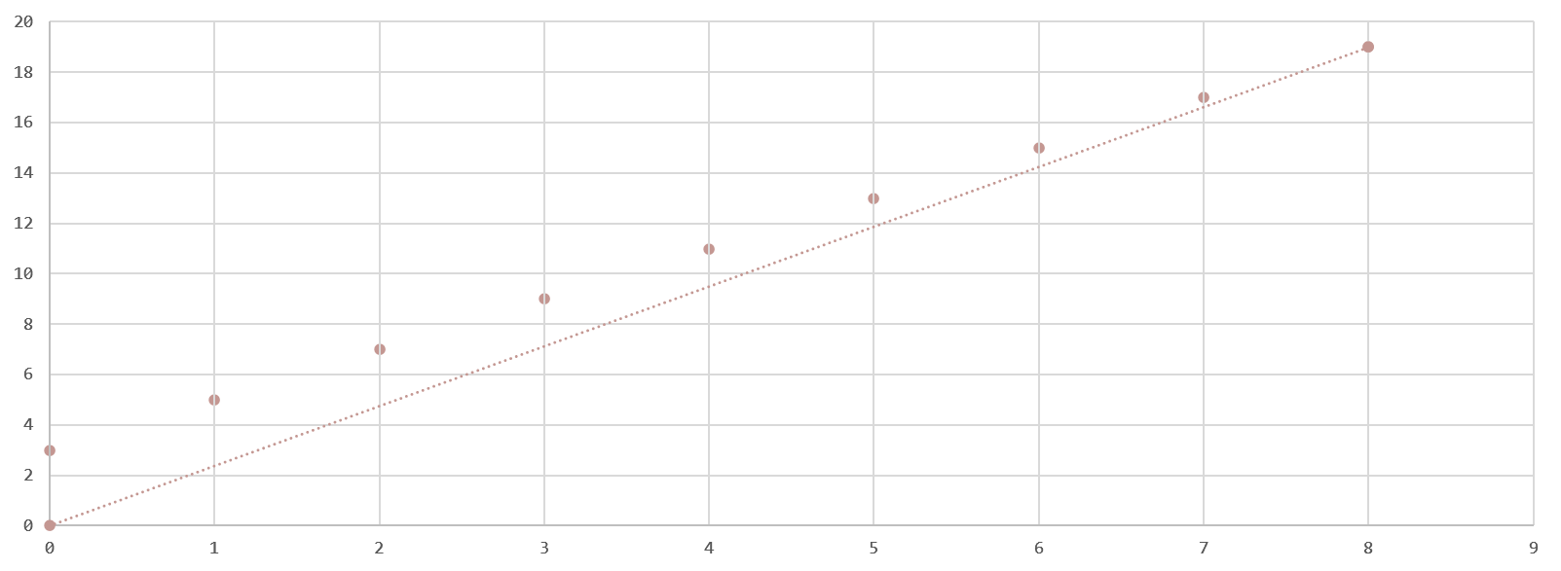

Machine Learning (Slightly More Mathematical)
$f\left(x\right)=2.375x+0$

Slide 12
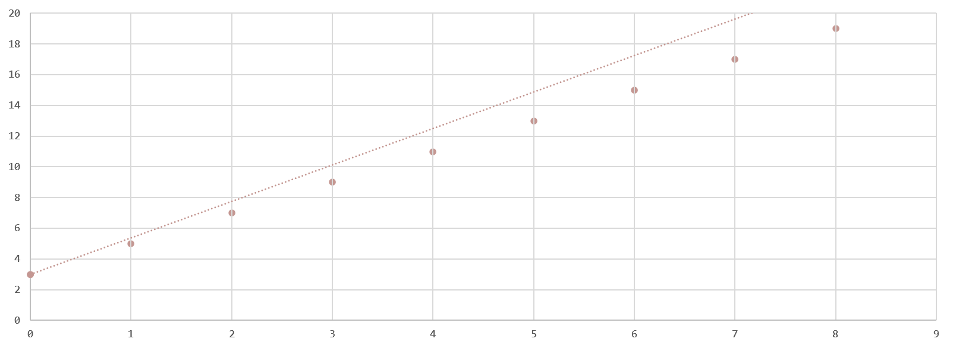

Machine Learning (Slightly More Mathematical)
$f\left(x\right)=2.375x+3$

Slide 13
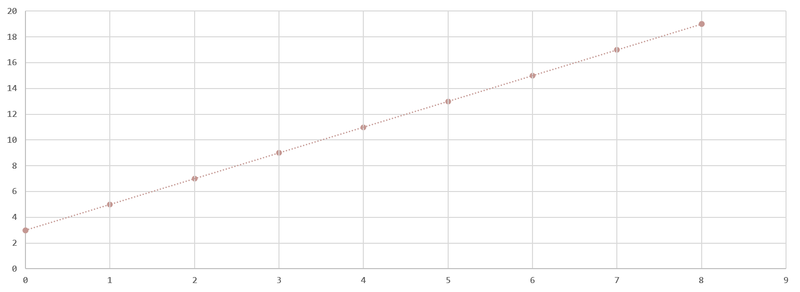

Machine Learning (Slightly More Mathematical)
$f\left(x\right)=2x+3$

Slide 14

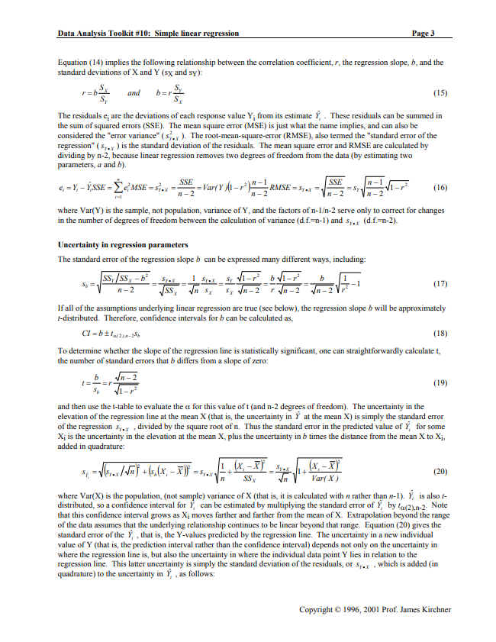
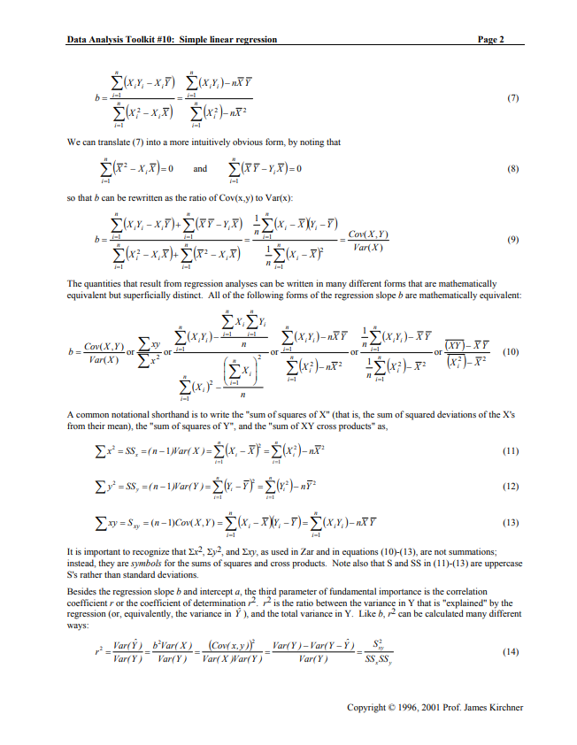
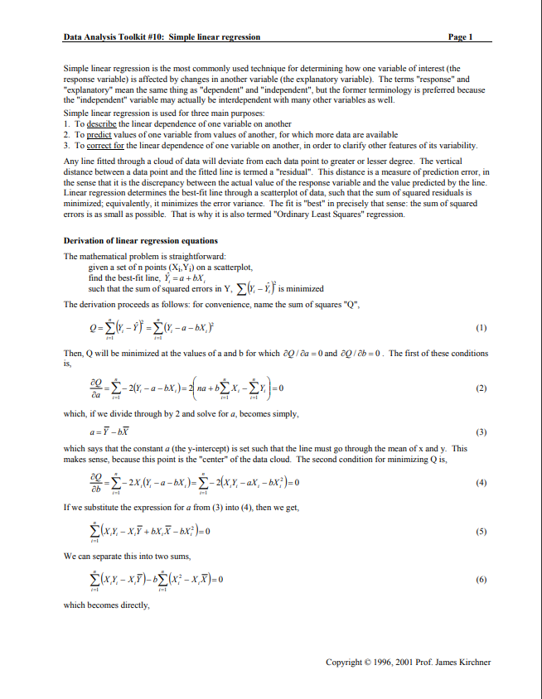
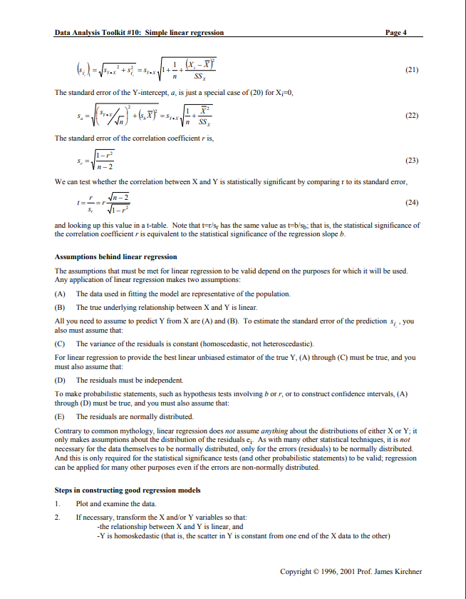

Machine Learning (Very Mathematical)
$\text{Microsoft} \text{Word}\text{ − 10.}\text{simple} \text{linear} \text{regression}\text{.}\text{doc}\text{ (}\text{berkeley}\text{.}\text{edu}\text{)}$

Slide 15
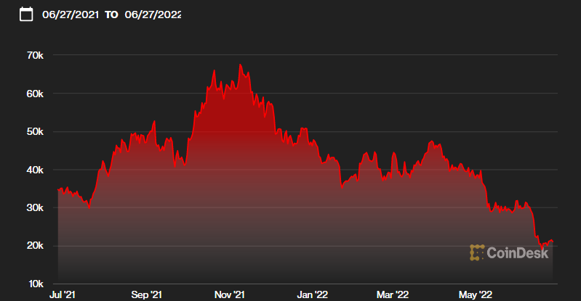
Why is that useful?
Markets (Bitcoin Price | BTC Price Index and Live Chart — CoinDesk 20)

Slide 16
Machine Learning
Algorithms:
Linear Regression
Logistic Regression
Support Vector Machines
Decision Trees
Naïve Bayes Algorithm
Hierarchical Clustering, etc
Divides into:
Supervised
Unsupervised
Reinforcement, etc

Slide 17
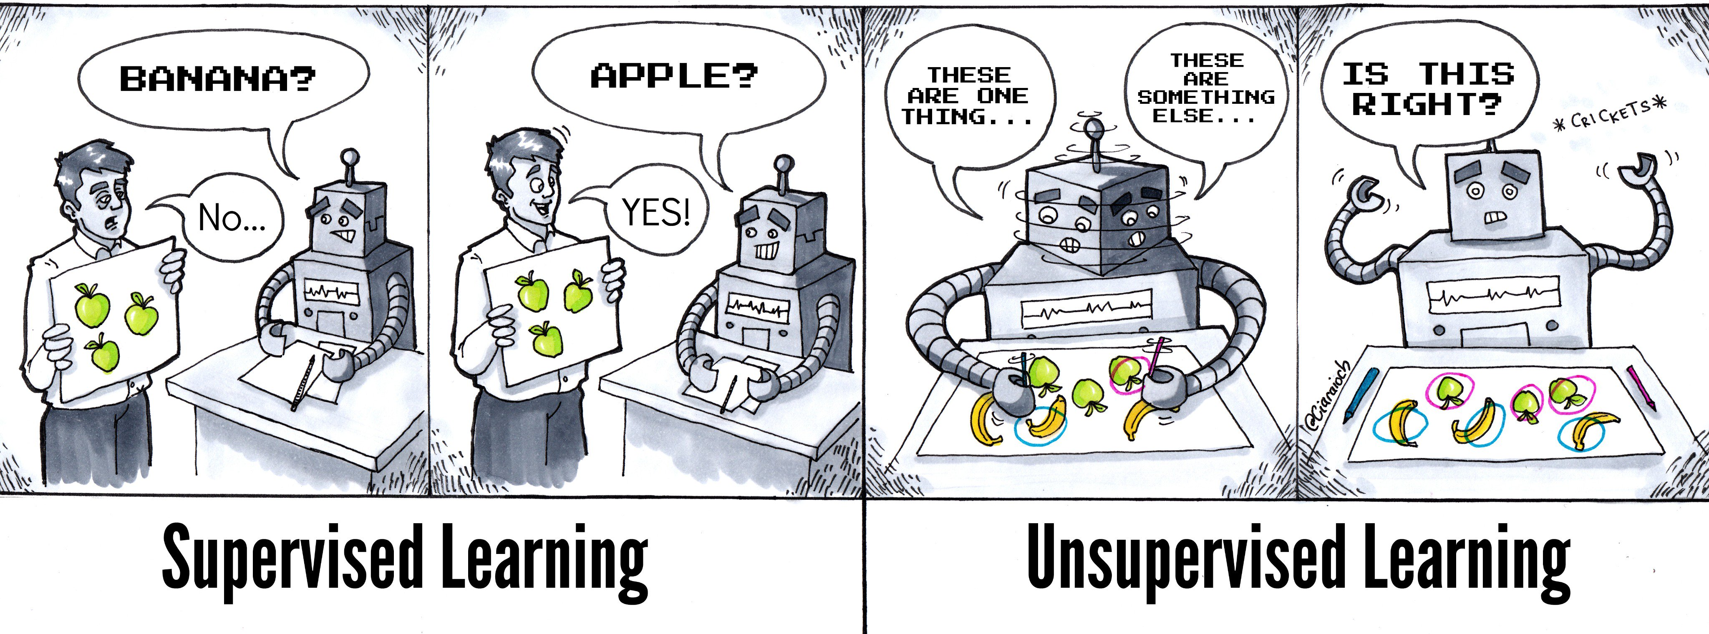
Supervised vs Unsupervised Learning

Slide 18
Supervised Learning
Regression – Mathematical Prediction of what will happen in the future
Classification – Separating items into different categories
We will be hosting future events mainly on supervised learning, stay tuned!

Slide 19
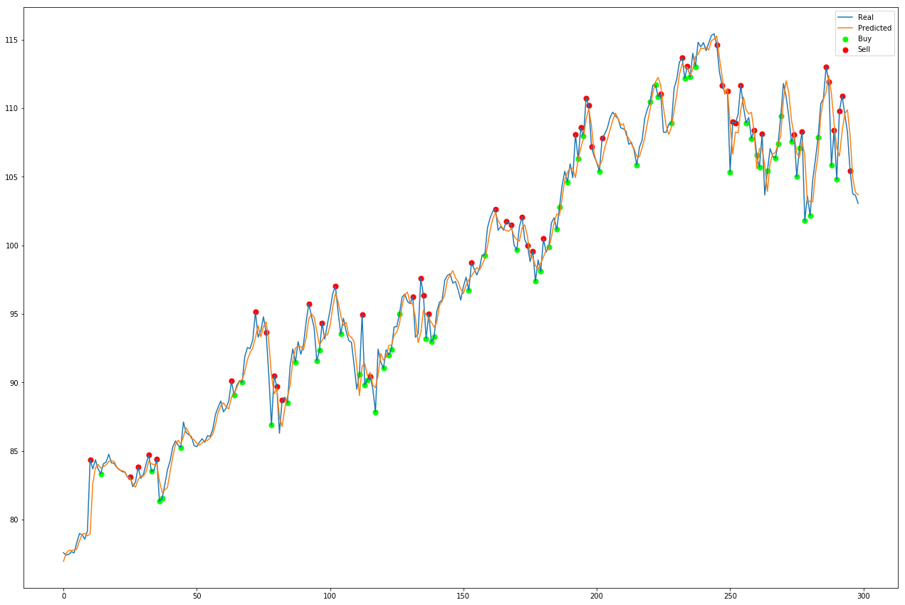
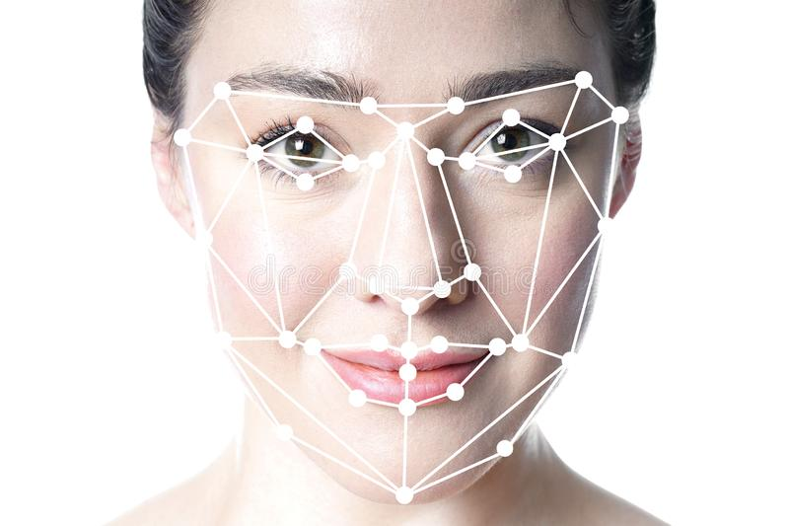
Real Life Examples of Supervised Learning

Slide 20
Unsupervised Learning
Clustering – Groups Data According to some Traits
Association – Finds Relationships between data

Slide 21
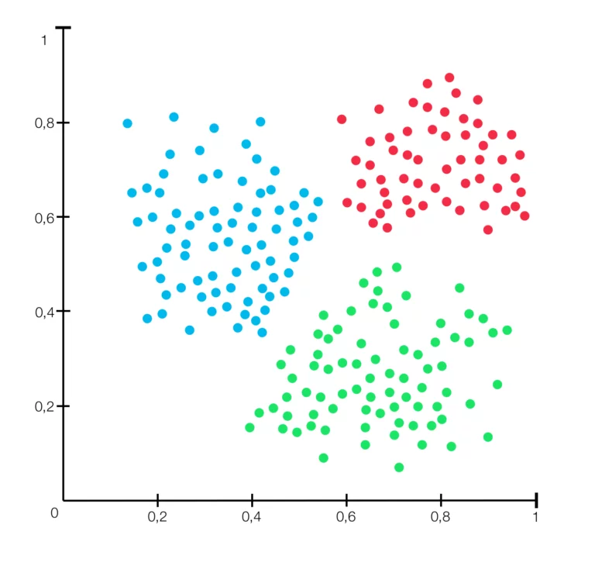

Real Life Examples of Unsupervised Learning

Slide 22
In Conclusion
Statistics is Mathematics
Machine Learning is (kind of) Statistics
Machine Learning makes Artificial Intelligence
Artificial Intelligence makes Data Science work

Slide 23
How does it help?
2,314 Exabytes of Healthcare Data – Healthcare data volume globally 2020 forecast | Statista
2,314 Exabytes = 2,314,000,000 TB
We can lay around 3.6 circumferences of iPhone 13 Pro Max (1TB) around the globe

Slide 24
